Slide 1
Traceability From The Manufacturers Perspective
Park Cakes
Site Technical Manager – Lisa Senior

Slide 2
Overview
About Park Cakes
Staff
Site
Products / Raw Materials / Suppliers
Traceability and Benefits
Proving Traceability
Recent Issue at Park Cakes

Slide 3
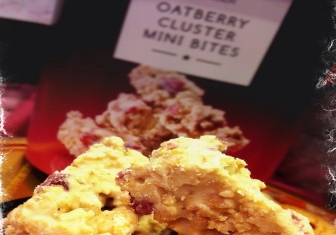
Overview Of Park Cakes
Business started 1937 Acquired by Northern Foods 1972 Acquired by Vision Capital 2007
£116m business: ~£70m M&S 2 sites: Oldham & Bolton Oldham site is 97% M&S Bakery Desserts Celebration ISB & Hospitality Balance of business with major multiples

Slide 4
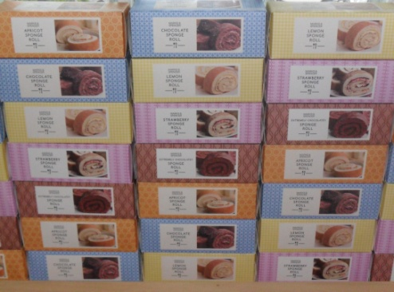
People
Employ 1200 People Retain industry leading skills 52% Highly Skilled 50% >10 years service, average is 19 years! Agency model for flexibility

Slide 5
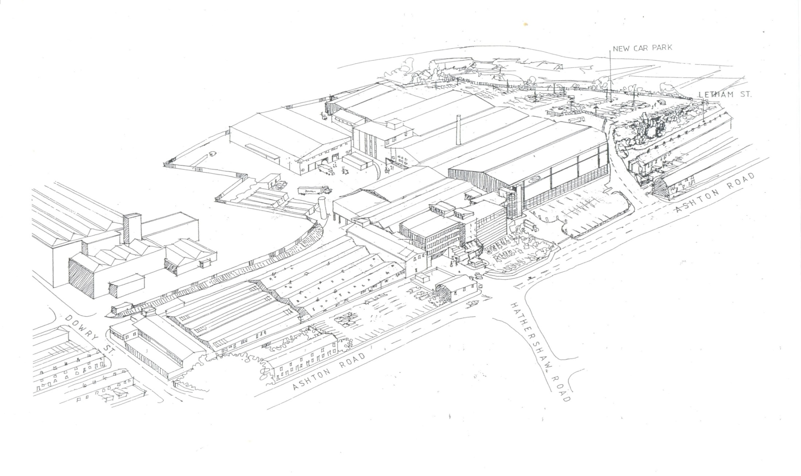
Oldham Site
Marlborough Desserts / Gluten Free
1971 & 2014
Despatch
Warehouse
1990
Bakewell
1963 &
1997
Honeywell
1963 &
1997
Offices
Beehive
1954
Hathershaw
Lane
Dowry Street
1959
Now Maintenance
Oldham is a 10.5 Acre site
With 8.2 acres of manufacturing floor space

Slide 6
Bakewell Bakery
Pastry, Band Sponge, Desserts, Clusters
Boxed Rolls
Mini Bites
Large Crumbles, Twin Pack Crumbles
In Store Bakery products
Hot Eating Pies
Seasonal products ie Stollen
Melt in the Middle Puddings
Gluten Free Bakery
Unit Cakes
Wedding Cakes
Marlborough Bakery & High Risk (Desserts)
Fresh Cream Cakes
Chocolate Brownie
Fresh Cream Filled Sandwiches
Eves Pudding
Bread & Butter Pudding
Honeywell Bakery
Whole Cakes, Extrude & Cut
Mini Cakes
Slices
Flapjack & Brownie Bites
Hand Decorated Celebration Cakes
FTO Wedding & personalised Cake
FSD -
Fruit Sieve and Debox Area
Supplying Sieved Ingredients Fruit Mixes/ Batters / Pastry to The Bakeries
Beehive Bakery
Band Sponge
Chocolate enrobing
Colin the Caterpillar
Mini Rolls
Mini Bite

Slide 7
Products / Raw Materials / Suppliers
- Currently have 145 Different Products (SKUs) being produced at the Oldham site and we are in the process of adding a further 180 SKUs over the next 4 Months.
- 42 Different Packing Lines Over all The Five bakeries
355 Raw materials Used On Site
- 145 Approved Raw Material Suppliers

Slide 8
Traceability and Benefits
Definition: Under EU law , “traceability” means the ability to track any food, feed, food-producing animal or substance that will be used for consumption, through all stages of production, processing and distribution.
Recognised benefits of traceability include: ● Ability to determine the origin of a product, ingredient or component. ● Simplifies problem-solving in event of defective or contaminated product, ingredient or component. ● Allows issues to be more quickly identified, contained and resolved. ● Limits losses and lowers costs. ● Protects public health and safety. ● Builds trust and confidence in products & businesses. ● Improves operating efficiencies.

Slide 9
When do we need to prove Traceability ?
Annual Site Audits
- BRC Audit unannounced
- M&S PPC Audit
- Tesco PIU, unannounced
Asda Assured Supplier Audits , unannounced
Warburtons Annual Supplier Audit
Local Council Visits (EHO & Trading Standards)
All these require a full traceability exercise to be complete within a 4 hour time frame and a mass balance .
Must be able to prove a forward traceability i.e. One batch of a raw material and what products this has ended up in / one batch of product and where it has been sent.
Backwards traceability picking one Finished product code and tracing back to every raw material involved in the make up of this.

Slide 10
When do we need to prove Traceability ?
When an issue with food safety or food quality has come to light through .....
An alert sent out by a raw materials supplier.
Issues picked up through testing / taste panels
Wrong Coding / Labelling.
Customer Complaint investigations, be it a foreign body or a trend in poor quality complaints.

Slide 11
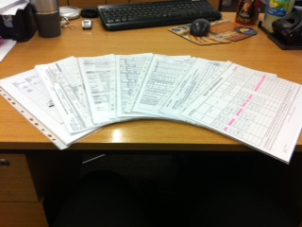
Information needed for traceability
Start up / engineering works & PPM records
Finished Product Weights & Packing
Weigh up /Sieving /Filtering /Mixing Documents
Micro & Cleaning Records Chemical Checks
Despatch Documents & SAP Records
Baking and Component Weights
Raw Material Intake Documents

Slide 12
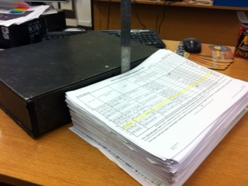
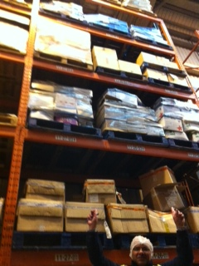
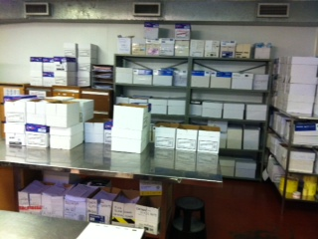
What Does That Mean for Traceability
One of 6 warehouse bays where we keep 5 years worth of traceability Paperwork
One product run worth of traceability paperwork
Half of three months worth of paperwork

Slide 13
Recent Issue at Park Cakes
Strawberry Sandwich and Apple Sandwich
Through Routine daily Internal Taste Panel on the strawberry sandwich a strong waxy taste was picked up that was sponge based rather than fillings.
Found that approx 7% of the 5,000 cakes we had made that day had this taste .
And some samples tasted from previous days run also showed .

Slide 14
First Steps
Put all Product still on site an hold .
Phoned the customer , explained the issue and was made the decision made to pull all date codes on the shelf for both the Victoria Sandwich Products .
Pulled all the traceability paperwork out and began the investigation into the possible cause .

Slide 15
Ingredients Traceability
Raw Materials For Sponge
New Gen 912
Granulated Sugar
Bex Baking Powder
Veg Oil
Vanilla Flavouring
Cresawhip 450G
Salted Butter
Milk
Pasteurised Whole Egg
Roll Off
Traceability showed all but roll off was common to at least 56 products on site
Roll off tank was new that week and specific to the Victoria bases on site not used on any other product .
All components in use sent to BRI Campden for testing along with engineering greases and lubricants in use & affected products

Slide 16
Considerations For sponge Contamination potential contaminants found In Area
 | Intake | Storage | Sieve Debox | Weigh Up | Batter Mix | Deposit In Tins | Bake |  | Cooling Post Bake |  | Store ambient / Freeze | Use
Raw Materials | No Issues Upon Receipt | Normal Storage area in use | Usual area and equpment in use | Usual area and equpment in use | Usual area and equpment in use | Usual Tins and equpment in use | Oven the usual one |  | usual area |  | The affected bases had been through both process rule this stage out
Cleaning Chemicals |  |  | Holdet/ Terminol On ring Main used at recomended Concentrations | Holdet/ Terminol On ring Main used at recomended Concentrations | Holdet/ Terminol On ring Main used at recomended Concentrations | Holdet/ Terminol On ring Main used at recomended Concentrations |  |  |  |  | The affected bases had been through both process rule this stage out | Holdet/ Terminol On ring Main used at recomended Concentrations
Equipment |  |  | Sieves and bins all used reulary for this and other products ( Marbborough Low Care area Up Stairs ) | Scales/ scoops / bins all in use reularly for this and other products Marborough Low Care Area Downstairs ) | Mixer (Morton mixer) in use reularly for this and other products ( area Down Side of Oven One ) | Roll Off & Batter Deposior / food contact utensils all in use reularly for this and other products | Tins specific to Victoria bases all been in use and used 3 /5, 5 Days a week . Oven in use reularly for this and other products . |  | Cooling are post Bake in use reularly for this and other products . No Change to this at anytime through January. |  | The affected bases had been through both process rule this stage out
Engineering Lubricants | Food Safe Lubricants and greace From Approved List |  |  |  | Food Safe Lubricants and grease From Approved List | Food Safe Lubricants and grease From Approved List | Food Safe Lubricants and grease From Approved List |  |  |  | The affected bases had been through both process rule this stage out | Food Safe Lubricants and grease From Approved List
Other |  |  |  |  |  |  | Natural Gas , Confimation from engineers no issues with this Oven has been re checked ( gas does contain hydrocarbons ) |  | White Trays & Grease Proof Once de tinned put in clean white trays (had been through the usual traywash) same as all other trays for factory and lined with grease prrof paper also common to whole site ) Filtered Air - checked with engineers no issues with this through January Filtering system/ air handling |  | The affected bases had been through both process rule this stage out
Packaging | Taint in sponge base Processing / pre - packaging Believe we can rule this source out.
Works in area/ On Equipment at time of issue ( Going Back 2 weeks) For RTM | None | None | None | None | None | None |  | None |  | None | The affected bases had been through both process rule this stage out
Works in area/ On Equipment at time of issue ( Going Back 2 weeks) For Complaint Use By 7.2.2014 | None | None | None | None | None | None |  | None |  | None | The affected bases had been through both process rule this stage out

Slide 17
Initial thoughts ......
Testing – suspect sponge samples showed elevated aromatic / aliphatic Hydrocarbon levels the source of which could not be determined through the ingredients testing results and swabs .
The only suspect ingredient was the roll off, Our Raw Materials Manager conducted a traceability audit with our suppliers .

Slide 18
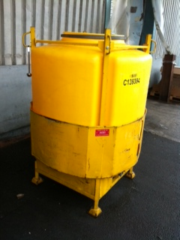
There was one thing highlighted through the supplier traceability their third party tank washers had gone out of business and this was one of the last tanks they had serviced . As a results our suppliers had a new tank washing service contract with a recently audited company .

Slide 19
Testing Results
Park Cakes Testing – suspect samples showed elevated aromatic / aliphatic Hydrocarbon levels the source of which could not be determined through the ingredients testing results and swabs .
The Roll off Supplier Testing swabs and engineering oils/lubricants could not determine source .

Slide 20
Outcome
Store RTM of Products costs £23,000.
£9,000 cost of product on site disposed of .
Testing of Ingredients/ swabs/ samples £5,500 .
Quick actions meant complaints limited to only 3 people (out of a possible 15,000 units) .
Although no definitive cause could be determined ,through traceability we were able to limit and narrow down to the two products and were back into production the next day with additional checks (after clean down and change of all ingredient batches) .

